Slide 1
Querying over Property Graphs
-By Sarthak Joshi, Burhanuddin Kamlapur Wala

Slide 2
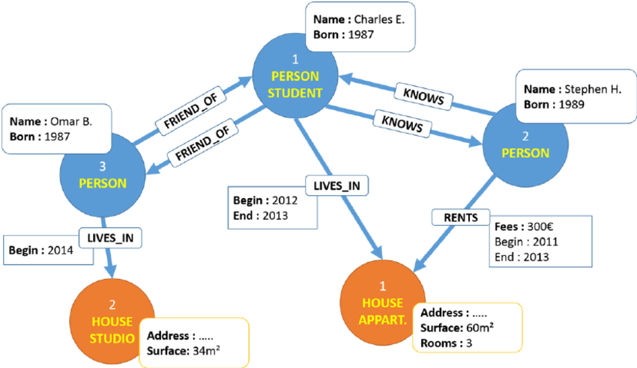
Property Graphs
A property graph associates a key-value pair properties to a graph vertices and edges on top of its underlying structure.
The vertices of the graphs are used to represent objects while the edges are used to represent the relationship across those objects.
Through this, a large amount of varied information can be stored as a network of related objects while both the objects and the relations have their individual parameters stored as key-value pairs.

Slide 3
Motivation
Property graphs are used to extract information about its nodes (or vertices) from a complex set of relationships (or edges).
For this purpose, property graphs are queried to obtain a set of nodes that satisfy a set of relationships.
Our primary objective is to efficiently query these graphs using Apache Spark.
We use the Graphframes library for the same.

Slide 4
Problem Statement
We are given an input as an array of conditions that need to be applied to a structural graph pattern which is also part of the input.
We need to obtain certain information from the graph out of all the vertices and edges that satisfy those conditions.
We need to provide the user an interface to easily input their structural pattern and the conditions on each vertex and edge which we would then apply to the graph to obtain the output.

Slide 5
GraphFrames
GraphFrames is a package for Apache Spark which provides DataFrame-based Graphs.
It provides high-level APIs in Scala, Java, and Python.
It aims to provide both the functionality of GraphX and extended functionality taking advantage of Spark DataFrames.
GraphFrames are to DataFrames as GraphX is to RDDs.
Given a vertex DataFrame and an edge DataFrame as an input, the package generates a GraphFrame object.

Slide 6
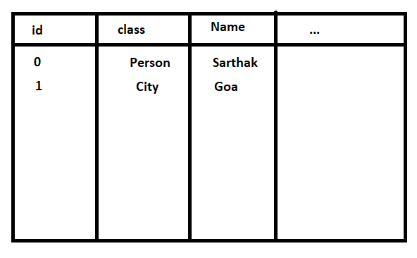
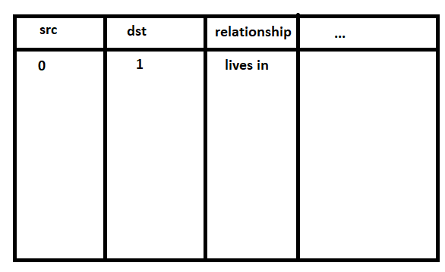
Graphframes
GraphFrame

Slide 7
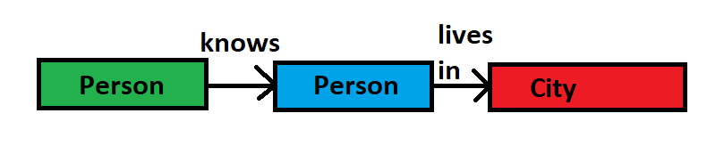
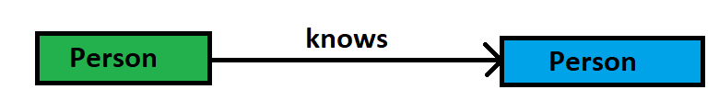
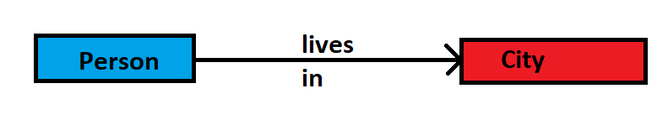
Query Decomposition
Path queries, as their name suggests, output paths from the property graph that satisfy the input properties.
These input properties are essentially an operation on the key-value pairs stored in the vertices and edges of the property graph that give a boolean (True/False) output.
If the output is True, then the property is considered satisfied.
We can further break down any such path query into a set of edges connecting a pair of vertices in which all 3 satisfy some input properties. This is equivalent to dividing the path into individual one-to-one links.

Slide 8
Motif Finding
The find method in the Graphframes library takes a motif finding string as an input.
A motif finding string is essentially a representation of path as a combination of single edges. Its basic format is ”(x)-[e]->(y)”.
Here x represents the source vertex, y represents destination vertex and e represents the edge connecting them.
All the vertices are enclosed by round brackets and all the edges are enclosed by square brackets

Slide 9
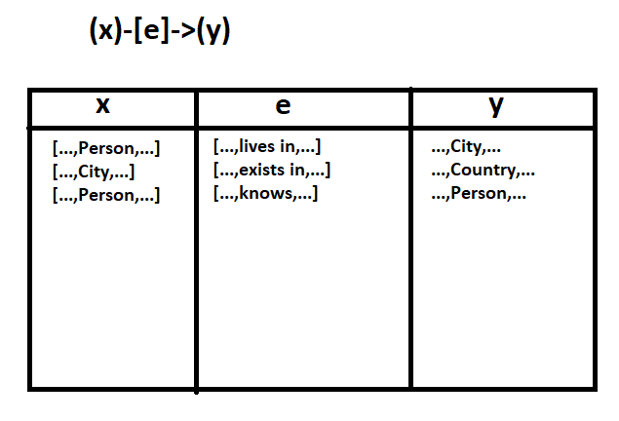
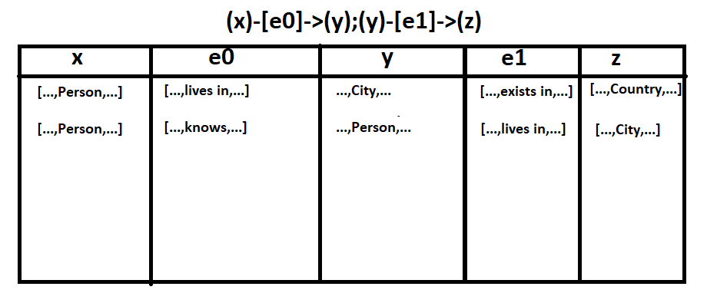
Motif Finding

Slide 10
Filtering
From the possible set of vertices in edges obtained as a result of individual motif strings, represented as a path table, we next filter out all the edges that do not satisfy the input property.
As this path table is also a dataframe, standard SparkSQL querying can be used on it.
First, each of the edges in the path are filtered such that they satisfy the conditions defined in the input.

Slide 11
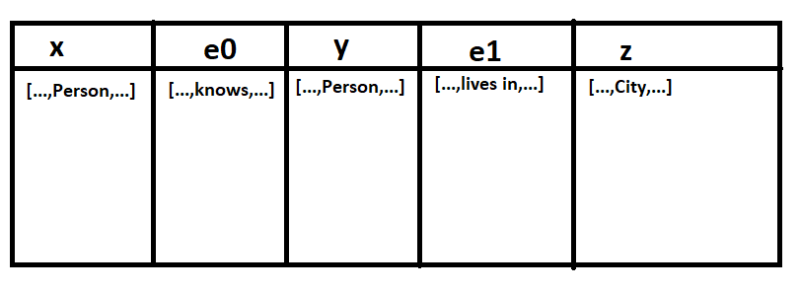
Filtering

Slide 12
Result Generation
With all the paths satisfying all the properties available, the path table can now be extended with more columns that are derived from the filtered entries.
It can also have its individual vertex and/or edge column entries that are rows of vertex and edge DataFrames respectively get expanded into individual columns representing the columns from the vertex and edge dataframes.
From here on, the desired output can be generated using standard SparkSQL operations by new deriving columns using the columns of the path table, further filtering, mapping or adding new entries by checking for conditions on the newly derived columns, repeating the process until the data required in the output is fully generated and selecting the columns required in the output.

Slide 13
Types of queries
There are two types of queries available to apply on graphs:
Path queries: Vertices, edges along with certain conditions based on vertices on vertices and relations on edges (optional parameters).
Length queries: Only involves length of path to be satisfied. Return all paths of length “n” (Can be formed using path queries)
Combination of both (to be implemented): Both kind of constraints can be attached with queries
R1
R2
…..
C1
C2
Ck
…..
Path of length n

Slide 14
Implementation
Each vertex and its edge is called component
Component can be created by just creating component object as shown below
component(conditions=[], v_name=””, e_name=””, relation=””, next=None)
Chain of components can be used to form query with conditions on vertices and relations on edges
“vertex_name”
att1=val1
att2=val2
.
.
“vertex_name”
att1=val1
att2=val2
.
.
“vertex_name”
att1=val1
att2=val2
.
.
Relation 1
Relation 2
(edge_name)
(edge_name)
Component 1
Component 2
Component 3

Slide 15
Make Components and queries
To make simpler queries using components we have to create chain of components. There are two ways to do it:
Create component objects for each of the node and its next edge, In case of last node next edge will be None
component(conditions=[], v_name=””, e_name=””, relation=””, next=None)
Merge these components to form chain of component using function
merge_components(*components, edge_names=[], relations=[])
Call function searchByComponents(component) to get results.

Slide 16
Make Components using Arrays
Make an array with n elements, each element will represent a vertex and next edge.
Array: [element_1, element_2,....,element_n]
element_k: [vertex_name, conditions, edge_name, relation]
vertex_name (string): v_name of component
edge_name (string): e_name of component
relation (string): relation corresponding to edge
conditions (array): conditions on different attributes [[att1, val1], [att2, val2], [att3, val3]
Call the function searchByArray() to get results
Example:

Slide 17
Queries as string
There are additional functions provided which can be used to obtain string of query along with conditions and relations described:
get_query_string_without_conditions(component)
Return: query, conditions(array), relations(array)
get_query_string_with_conditions(component)
Return: query, conditions(array), relations(array)
query is string which can be directly used as length queries
Condition at position i represent conditions at vertex i.
Relation at position i represent relation of edge from vertex i to i+1.

Slide 18
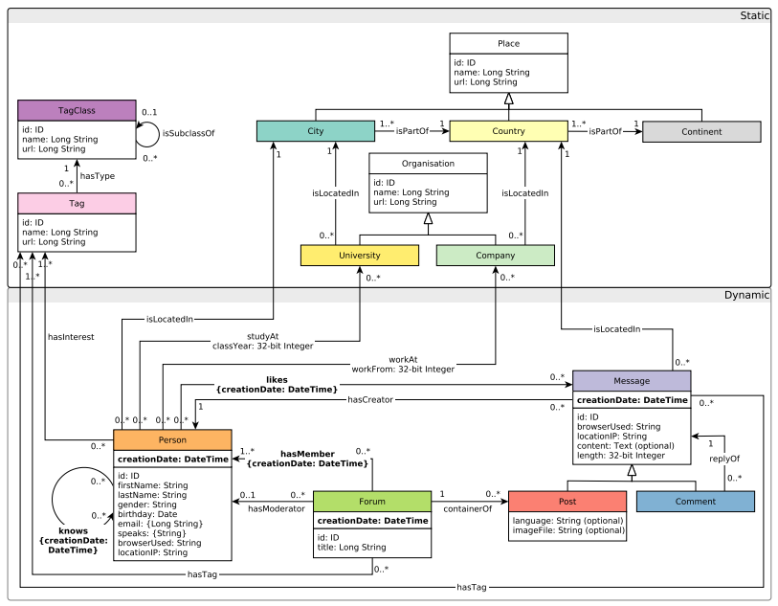
Experiments
Tests conducted on a Google Colab notebook.
Tested on a LBDC SNB (Social Network Benchmark) graph.

Slide 19
Experiments
Three benchmark queries tested:
Transitive friends
Recent messages by your friends
Recent likers
Successfully obtained the desired outputs for the test queries.

Slide 20
Future Work
Optimizing the techniques to detect and filter the condition that would have the most impact on the table first.
Comparing the performance and the scalability with other Graph Querying platforms.
Exploiting the persistent and immutable nature of RDDs (and thus DataFrames) to cache the output for a given query input to be easily returned later and even helping in computing some of the results of a similar query.

Slide 21
THANK YOU..!

